Slide 1
A PI LOCKER

Slide 2
Why pi locker?
I need to store safely (encrypted) my passwords, sensitive files, notes, etc.
I need to access them from anywhere, with every possible device ( desktop, mobile, terminal ).
I need those objects to be synchronized across all my devices.
I don’t want to use “the cloud”.
I don’t want to pay for a server.

Slide 3
Introduction
A-Pi Locker is a secure record/password manager with the help of raspberry pi zero which act as a server device to store and access the encrypted information from the client device.
I am using RESTful API to transfer the encrypted information from the server to client and vice versa.
In server side I use ReSTful API which is written in Google’s Go language which reads and writes the encrypted record/password on SQLite databases.
On the client side I run on HTML5 and JavaScript and it encrypts and decrypts the password/records using the CryptoJS for AES encryption and PRNG.

Slide 4
Why are we implementing this locker?...
To store safely (encrypted) passwords, sensitive files, notes, etc.
To access them from anywhere, with every possible device ( desktop, mobile, terminal ).
To synchronize those objects across all my devices.
To not to use “The Cloud”.
To not to pay for a server.

Slide 5
Components
There are three major components in this project which are:
Encryption: To perform the encryption of the objects i.e. passwords, files etc, using AES 256 bit key encryption algorithm.
Client: For the client interface, using ENC interface.
Server: For the server side using CANA, a RESTful API written in “GO” language and for storing purpose I am using SQLite database.

Slide 6
Encryption: AES ( Advanced Encryption Standard)
The Advanced Encryption Standard (AES), is a symmetric block cipher used to protect classified information and is implemented in software and hardware throughout the world to encrypt sensitive data.
Some of the features for choosing AES instead of other key encryption algorithms are:
Security: Competing algorithms were to be judged on their ability to resist attack, as compared to other submitted ciphers, though security strength was to be considered the most important factor in the competition.
Cost: Intended to be released under a global, nonexclusive and royalty-free basis, the candidate algorithms were to be evaluated on computational and memory efficiency.
Implementation: Algorithm and implementation characteristics to be evaluated included the flexibility of the algorithm; suitability of the algorithm to be implemented in hardware or software; and overall, relative simplicity of implementation.

Slide 7


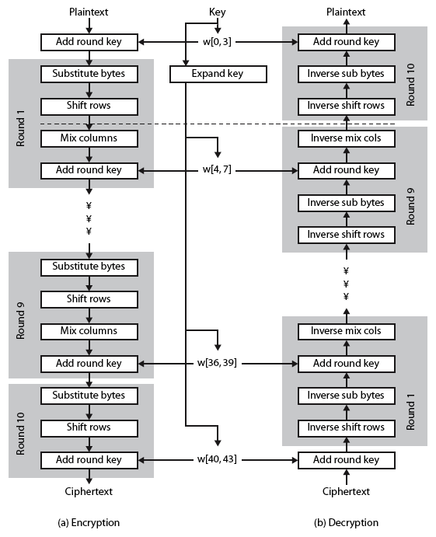
Structure of AES

Slide 8
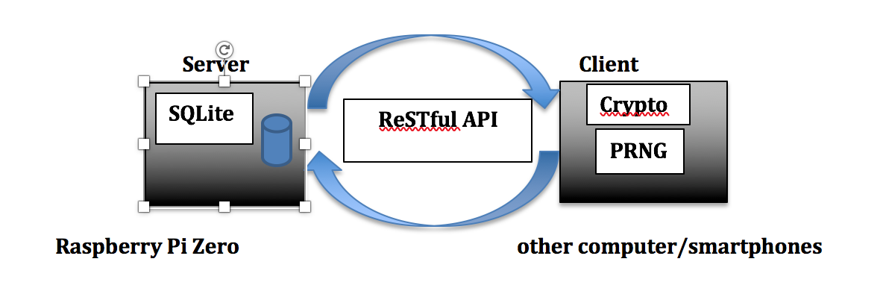
architecture

Slide 9
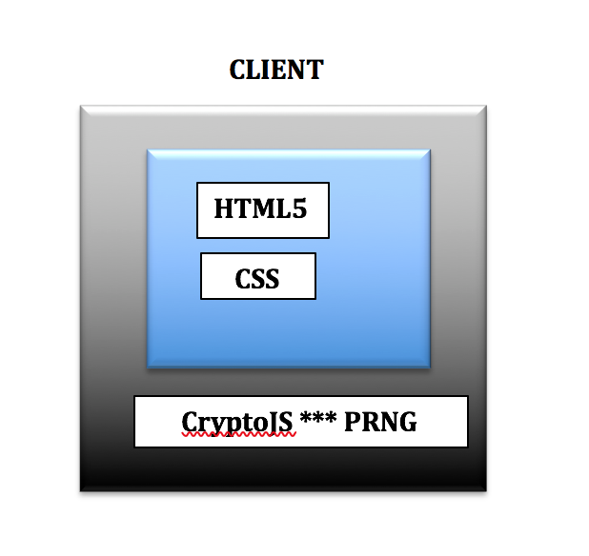
Client side

Slide 10
ENC is used as the client application for this pi locker this is implemented in html5 and javascript which runs in every html5 enabled browser.
Records are generated, encrypted and decrypted at the client side.
ENC relies on CryptoJS for the AES encryption that offers UI widgets that include
Simple text inputs
Simple text areas
Custom file attachments
A password field with password strength estimation and a random password generator

Slide 11
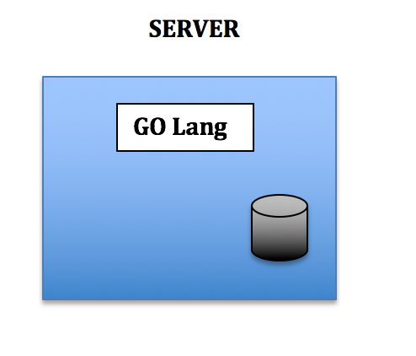
Server side

Slide 12
In the server side cana is the major component which is a Restful API which is created in Google “GO” Language.
From the client side the encrypted data is sent to the database in the sever i.e raspberry pi using this API
While encrypting the data a key should be provided for the AES encryption as it is symmetric key encryption the same is required to decrypt whenever the data is accessed.
This cana API acts as a mediator between client and database.

Slide 13
Security considerations
As all the data is encrypted on the client side and store physically on rpiz which uses aes encryption, we should use a stronger encryption key. the stronger the key, the safer the data.
Don’t enable any kind of connection sharing from computer to rpiz as we don’t want any other illegal sources to reach our secure storage.

Slide 14
DEMONSTRATION

Slide 15
THANK YOU

